Slide 1
WQD7007 Big Data Management
NoSQL and MongoDB

Slide 2
NoSQL
WQD7007 Big Data Management
NoSQL → Not Only SQL
being non-relational, distributed, and open source
Characteristics:
schema-free
easy replication support
simple API
Big data
Commodity
Flexible data model
Source: http://nosql-database.org/

Slide 3
MongoDB
WQD7007 Big Data Management
A document-based (e.g. JSON or BSON) database.
Characteristics:
Expressive query languages and secondary indexes
Strong consistency
Enterprise Management and Integration
Flexibility
Scalability and performance
Always on, global deployments
Source: https://www.mongodb.com/
Notes:
Secondary index: https://docs.oracle.com/cd/E17275_01/html/programmer_reference/am_second.html

Slide 4
JSON and BSON
WQD7007 Big Data Management
Java Script Object Notation (JSON) is the lightweight data-interchange format to exchange data.
Binary JSON → BSON: JSON that is serialized as a binary document
JSON build on two structures:
A collection of name/value pairs. In various languages, this is realized as an object, record, struct, dictionary, hash table, keyed list, or associative array.
An ordered list of values. In most languages, this is realized as an array, vector, list, or sequence.
Source: https://www.json.org/

Slide 5
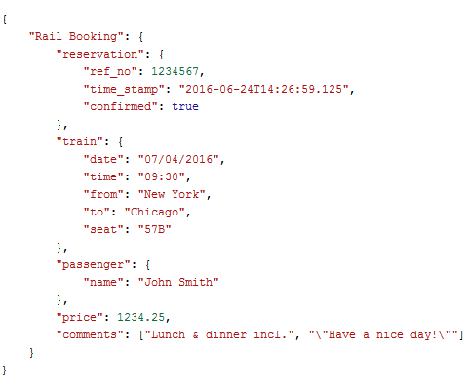
Example of JSON:
WQD7007 Big Data Management

Slide 6
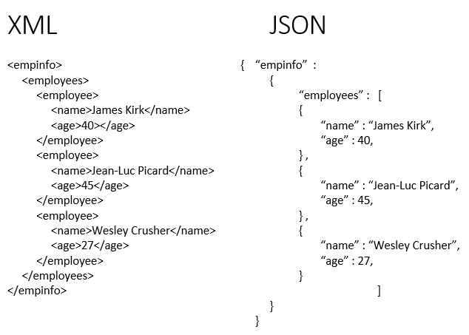
Why JSON and not XML?
WQD7007 Big Data Management
XML is not well suited to data-interchange. It carries a lot of baggage, and it doesn't match the data model of most programming languages.

Slide 7
MongoDB VS RDBMS
WQD7007 Big Data Management
MongoDB | RDBMS
Database | Database
Collection | Table
Document | Tuple/Row
Field | Column
Embedded Documents | Table Join

Slide 8
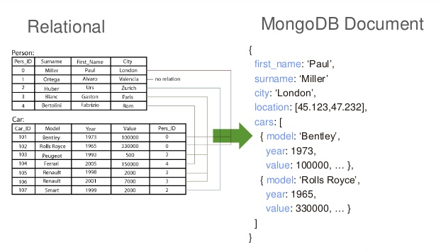
From RDBMS to MongoDB
WQD7007 Big Data Management

Slide 9
Benefits of using JSON (document model)
Document maps nicely to programming languages data type
Embedded documents and arrays reduces the need for joins

Slide 10
MongoDB vs HBase
WQD7007 Big Data Management
MongoDB | HBase
In MongoDB data is stored in JSON format. We have to insert/update/fetch the document as a whole | In HBase we can work on partial data.
MongoDB relies on the OS to buffer its data and maps the whole data to memory with mmap. | HBase use the log-structured merge tree, which probably is more efficient for heavy load and big data.
MongoDB supports secondary index and the index should be keep in memory. | HBase requires a third party module to support secondary index.
MongoDB has good feature of searching a document data using find/findOne by its inner attribute. The attribute can be indexed to search faster. | HBase do not have this feature.
Examples: Product/catalog data, geospatial data, Aadhar biometric database, ebay search suggestion | Examples: storing genome sequences, sports match histories, time-series data, log files
Source: https://www.oodlestechnologies.com/blogs/Comparison-Between-MongoDB-and-Hbase
Notes:
For MongoDB: If the data are in memory, the read and write will be very fast, otherwise, a page fault is issued so the the OS will load the data into memory, which is expensive. As a result, MongoDB is memory thirty and we can see very different read/write behaviors for the two cases.
10 common task for MongoDB: https://www.infoworld.com/article/2612785/application-development/10-common-tasks-for-mongodb.html
Real world use case for MongoDB: https://www.edureka.co/blog/real-world-use-cases-of-mongodb/
Applications for Hbase: https://www.packtpub.com/mapt/book/big_data_and_business_intelligence/9781783985944/1/ch01lvl1sec15/applications-of-hbase
Real life examples for Hbase: https://www.quora.com/What-are-some-specific-real-world-examples-where-HBase-was-the-right-tool-to-use

Slide 12
Introduction
Download MongoDB in https://www.mongodb.org/downloads#production
If you’re using Mac, you can use Homebrew
For Windows:
This lab assumes that you install it to C:\Program Files\MongoDB. Add the bin directory to your System Environment Variables
If you’re using any other operating systems, please refer to this https://docs.mongodb.org/manual/installation/ for more info
During installation, you’ll be required to install it to a PATH. Remember the path that you installed MongoDB to.

Slide 13
Running MongoDB Server
Before you proceed, you will need to create a directory which stores your MongoDB data. It is always /data/db by default. (For Windows, it’s C://data/db/.) Create that data directory.
If you can’t create the directory in Mac or Linux, use “sudo” privileges
Finally, head to your terminal and type mongod --smallfiles --noprealloc to start your MongoDB Server.
If it states “no such command is recognized”, that means you have not added the bin directory into your PATH
If you use “sudo” privileges to create path, please use “sudo” privileges for this command too

Slide 14
Run MongoDB
open a new terminal (or a tab), and type mongo.
Basic commands:
show dbs: Show the names of all databases
show collections: Show the names of all collections in the database
use dbname: Change to the database named dbname
db: Returns the name of the current database that you are connected to

Slide 15
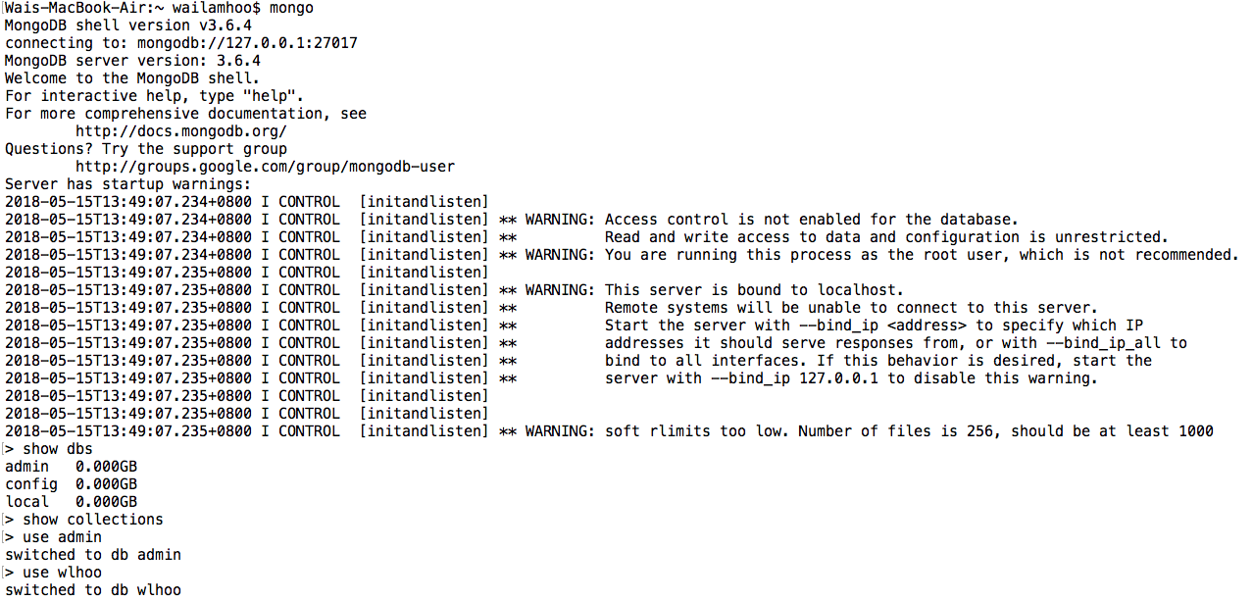
Run MongoDB

Slide 16
Run MongoDB
There will not be any commands to create a database. If the database does not exist, say when you do use random1234, Mongo will create a database called random1234 for you. So, be careful in your syntax!
Mongo by default connects you to the test database upon opening a connection.

Slide 17
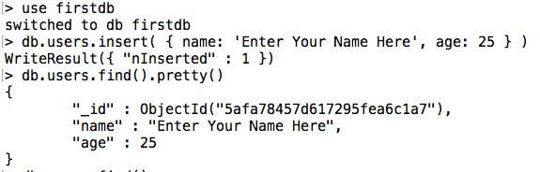
Create database and Insert Data
We’ll now be using a new database called firstdb , and we’ll be inserting some entries into the collection named users.
use firstdb
db.users.insert( { name: 'Enter Your Name Here', age: 25 } )
db.users.find().pretty())
Notes:
db.users.find({age:20}?

Slide 18
Import JSON file
Assume you download the JSON data, stored it in Desktop and wish to import to MongoDB:
mongoimport –d school –c students < ~/Desktop/student.json
Enter mongoDB by typing mongo. Then, switch to school database by typing use school

Slide 19
Inserting data
Try insert these documents!
Id | Name | Scores
200 | Drake | []
201 | Logic | [{“type”: “homework”, ”score”: 89}, {“type”: “quiz”, ”score”: 56}]
202 | Kraimir | [{“type”: ”homework”, “score”: 11}]

Slide 20
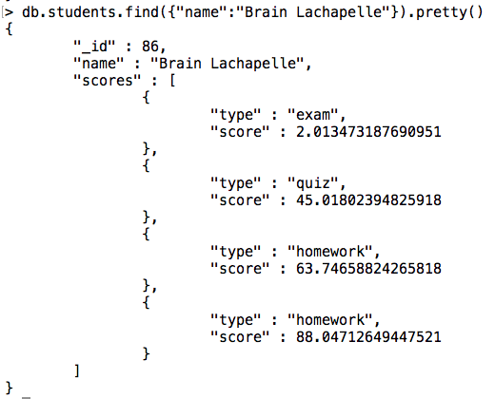
Finding documents
Example: Display the details of the student named “Brain Lachapelle”

Slide 21
Finding documents
Obtain the number of students who achieved a a score greater than 95 of any type.
Hint: find(), $gt, dot notation, count()
Display the student who achieved the highest score on any type in the whole school
Hint: find(), sort(), limit()
Display the _id and name of the first 10 students (arranged in alphabetical order by name) who achieved a score between 10 and 35 of any type
Hint: find(), dot notation, $lt, $gt, projection (second parameter of find()), sort(), limit()
What is the number of students whose names are between C and E lexically? Also, display only the name of 10 of these students, in descending order
Hint: find(), $gt, $lt, projection, sort(), limit(), count()

Slide 22
Updating and removing documents
Update from one value to another
db.users.update({“username”:”admin123”}, {$set: {“password”: “secret”}})
Removes “profile ID” attribute
db.users.update({“username”:”admin123”}, {$unset: {“profile_id”: 1}})
Increments “login_count” value by 1
db.users.update({“username”:”admin123”}, {$inc: {“login_count”: 1}})
Insert a new permission in “permission” array
db.users.update({“username”:”admin123”}, {$push: {“permissions”: “add_blog”}})

Slide 23
Updating and removing documents
Removes the first element from “permission” array:
db.users.update({“username”:”admin123”}, {$pop: {“permissions”: -1}})
Removes the specified element from “permission” array
db.users.update({“username”:”admin123”}, {$pull: {“permissions”: “edit_bg”}})
Insert the specified element to “permission” array
db.users.update({“username”:”admin123”}, {$addToSet: {“permissions”: “edit_blog”}})
Remove user
db.users.remove({“username”:”admin123”})
Notes:
Extra:
Increase the “login_count” of all users with the attribute “is_admin” s true by 1
db.users.update({is_admin: true}, {$inc: {“login_count”: 1}}, {multi: true})

